Slide 1




NYU-6463-RV321 Processor
Group 5
Dajr Alfred: dva240
Artem Shlepchenko: as14836
Shubham Shandilya: ss15590

Slide 2
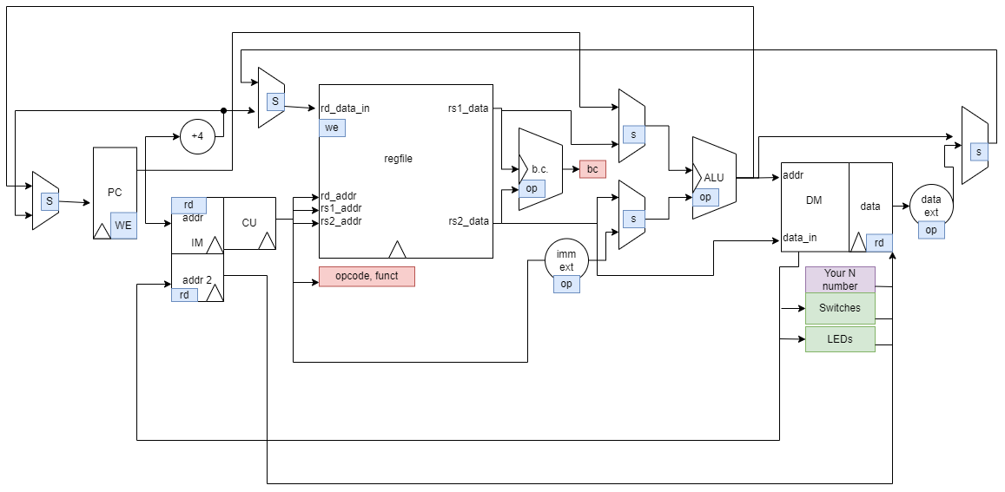
Processor Diagram

Slide 3
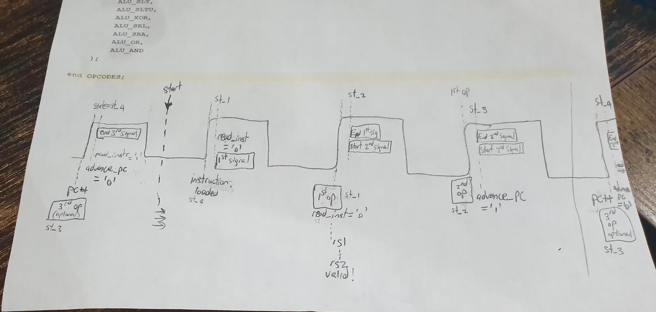

Slide 4
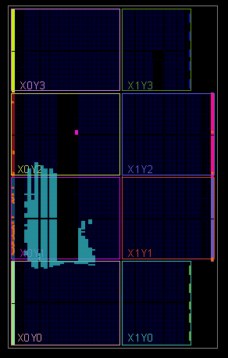
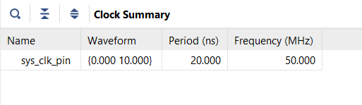
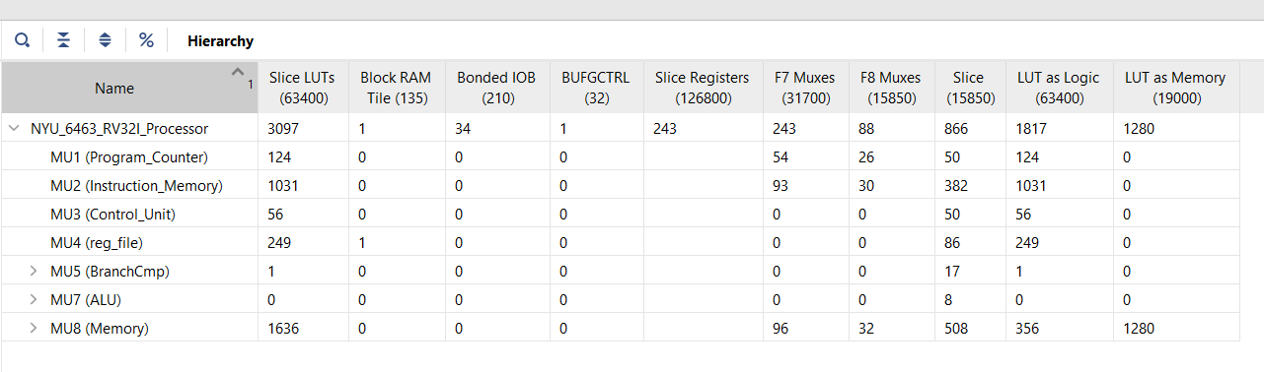
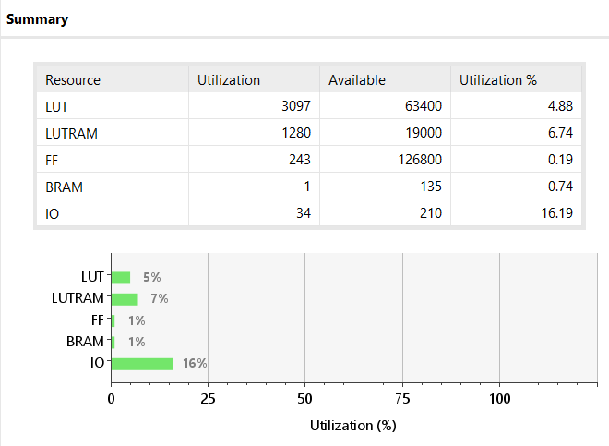
Implementation

Slide 5
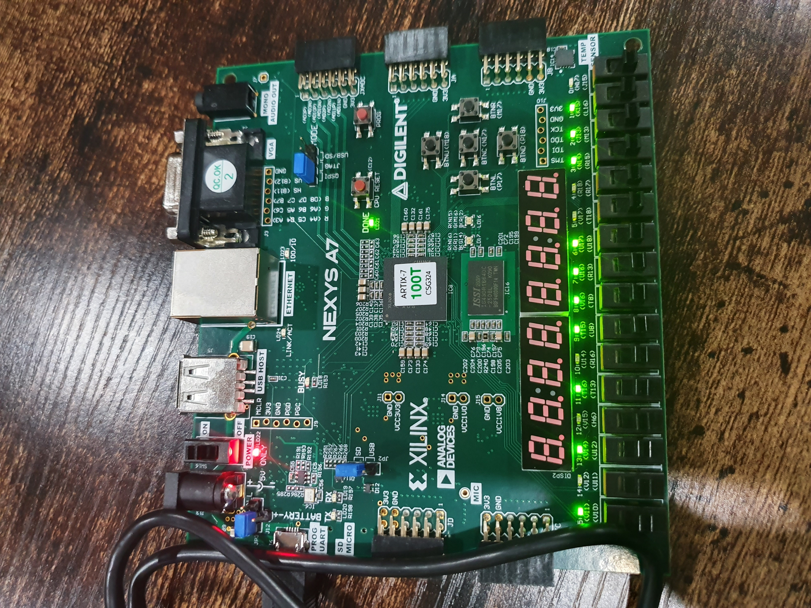
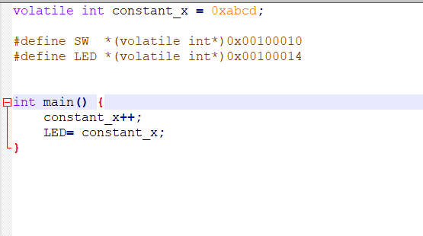
C Test Example

Slide 6
Fin.

